Slide 1
From Data to Recommendations: Building an Intelligent System with Ruby on Rails
By: Rashmi Nagpal
Notes:
Hi everyone,
I am Rashmi Nagpal, Machine Learning Engineer by profession and a researcher by passion. Today I am really excited to present on the topic titled as from the data to recommendations, building intelligent systems with ruby on rails. So, without any further adie lets delver into this journey together.

Slide 2
Agenda
Introduction | What is Artificial Intelligence!? What are its building blocks!?
Intelligent Systems | Why do we need Intelligent/Recommendation Systems?
Overview of Collaborative Filtering | How it works! What are the algorithms we can use!?
Building CF system | Let's build a collaborative filtering system in Ruby
Challenges & Considerations | What are the challenges while building recommendation systems?
Conclusion and Resources | Bunch of references for future
Notes:
So, the agenda of the talk is, firstly we will discuss what is machine learning / artificial intelligence to bring all of us on the same page, and then we will understand why do we need intelligent systems or recommendation systems, and further we will see how can we develop such systems. On top of that, we will understand the concepts of collaborative filtering which is used in building recommendation systems via a demo, and further challenges and towards the end bunch of resources for future reference. So lets begin.

Slide 3
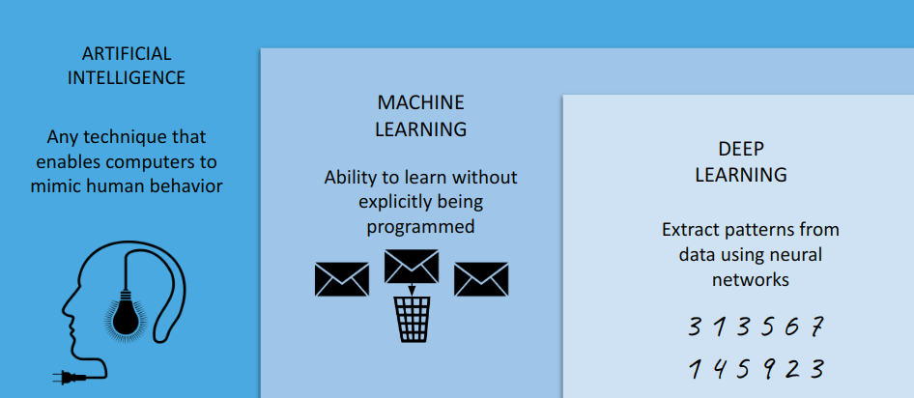
Introduction
Notes:
AI is a very broad term, which implies any program or a technique that mimics human behavior; while ML is a subset of AI, which focuses on development of algorithms that learn from the dataset and its corresponding features and it gives the output, while Deep Learning is a subset of ML, which extracts the patterns from the dataset and gives data-driven decisions. For instance, hand-writing recognition is an example of Deep Learning; while Spam email detection is an example of Machine Learning.

Slide 4
Demo (Machine Learning)
Use-Case: Predict the price of the house, given housing dataset with features like the neighbourhood, location, sale price, square feet, block, lot et al.

Slide 5



Test the waters!
A
B
C
Notes:
Okay, now I have explained the basics, let me test the waters. I want you to take a minute and think. Think which of these faces are real? Please raise the hand if you think it's face A, please raise the hand if you think it's face B - ah, I see 25% of the audience, okay now please raise the hand if you think it's face C! Perfect, so nearly 80% of the audience raised their hands for either of the faces A, B or C.
Well, the truth is none of these faces are REAL! These people do not exist on the planet Earth to say the least, can’t comment on the extraterrestrial planets though! This is an application of Deep Generative modeling in which algorithms are not only learning patterns from the dataset but going a step beyond in synthesizing brand new data instances based on the learned patterns. This is a very complex and incredibly powerful idea which has exploded in the recent past. For instance, ChatGPT, Dalle-E are some of the examples of Generative AI. But, wait a minute, what’s the building box behind these algorithms - that’s where neural networks come in the picture.

Slide 6
Basic Neural Networks
1
0.3
0
1
0.8
-0.1
If > 0.5
Σ
0.6
1
0.4
ACTIVATION FUNCTION
OUTPUT
SUM AND BIAS
WEIGHTS
INPUT
Notes:
This is a basic structure of Neural Network, in which given the dataset as an input, you run a machine learning algorithm; for the time being consider the machine learning model as a black-box which comprises weights, sum and bias and activation function to give an output or the result that you are trying to achieve via your use-case. Let’s understand this structure through an example!

Slide 7
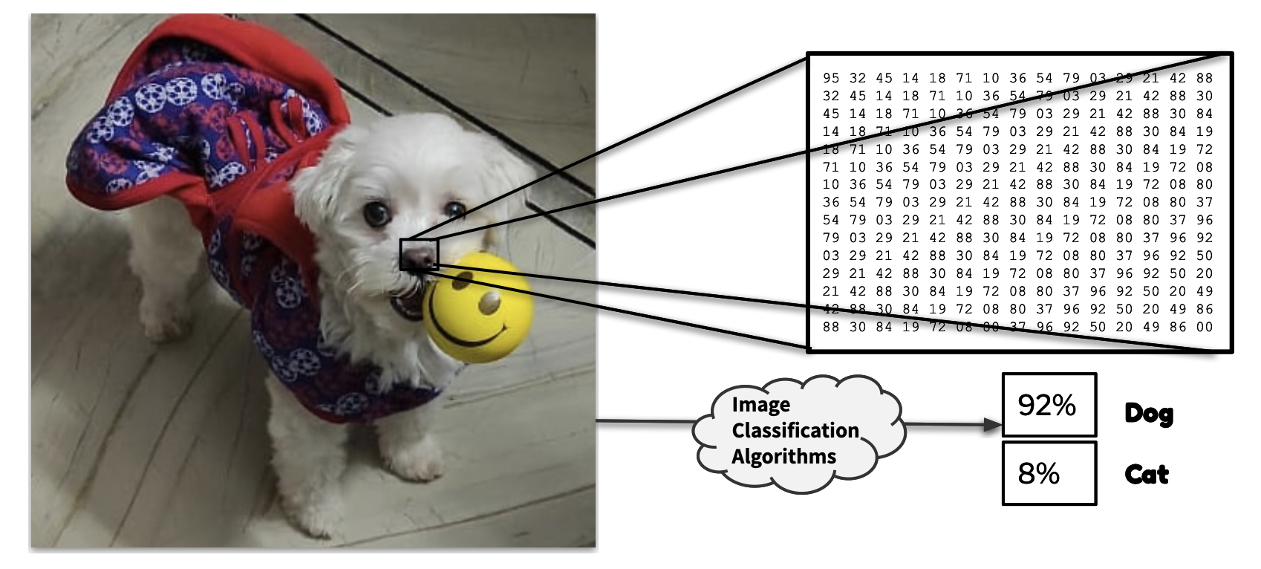
Notes:
Here our use-case is, given an image, determine to which animal category this image belongs? So, you will feed the image dataset as an input, and the system which understands it as a combination of 0’s and 1’s, and then it will give you an output with certain confidence or an accuracy. Here it is suggesting that this image belongs to the dog category with 92% confidence.
Okay, so now we want to deploy this image recognition example, for our end-users, so what will be the machine learning pipeline in that case?

Slide 8
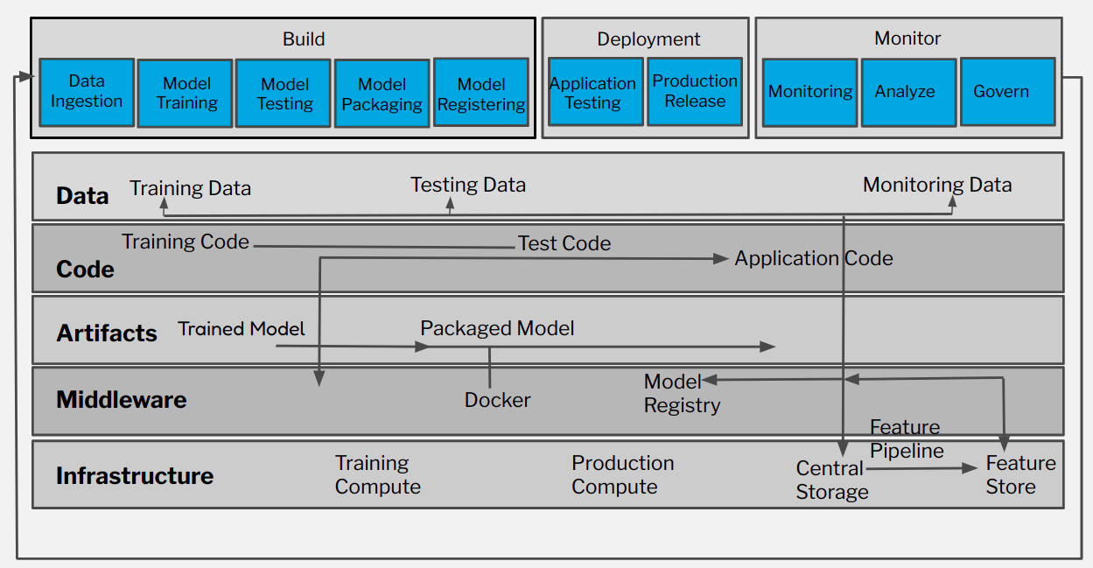
Machine Learning Pipeline
Notes:
This infographic shows the end-to-end ML pipeline or the ML system holistically which comprises three main stages: First is the build stage, next is deployment stage and lastly is the monitoring stage. In the build pipeline - you are not only ingesting the input dataset, but doing preprocessing and post-processing of the data, model training, model testing and further packaging and registering the model. While in the deployment stage, your application is released in the production / development environment and is made available to the end-users. While in the monitoring stage you are analyzing and governing the model and re-iterate the build stage if anything goes wrong.
This is on a very high level machine learning system, stages / pipeline, but wait what if we want to build a recommendation system!

Slide 9
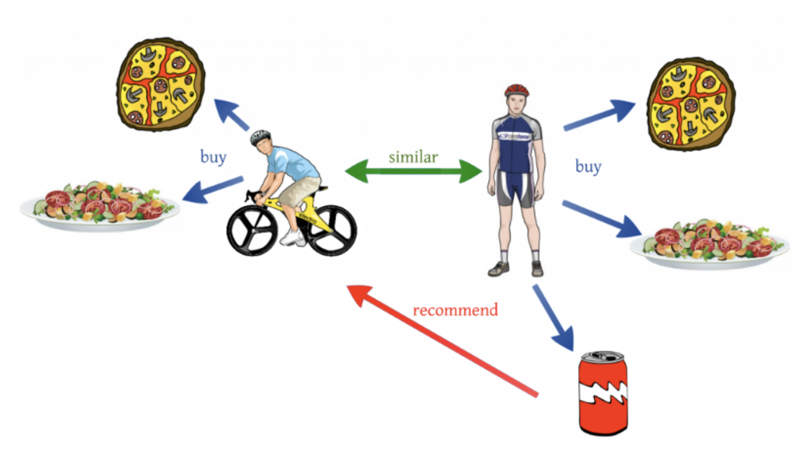
Recommendation System
Notes:
Recommender systems are trained to understand the preferences, previous decisions, and characteristics of people and products using data gathered about their interactions. These include impressions, clicks, likes, and purchases. Because of their capability to predict consumer interests and desires on a highly personalized level, recommender systems provide personalized content. They can drive consumers to just about any product or service that interests them, from books to videos to clothing.

Slide 10
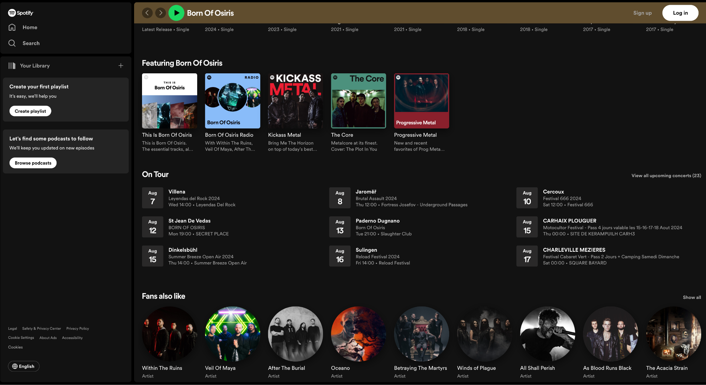
Example of recommendation system(s): Spotify
Notes:
For instance, Spotify provides music recommendation. Like the other day I was listening to the metal music, and then it started suggesting me oh probably you will like other metal bands. So, these systems basically entice the users with relevant suggestions based on the choices we make. By we I imply the users.

Slide 11
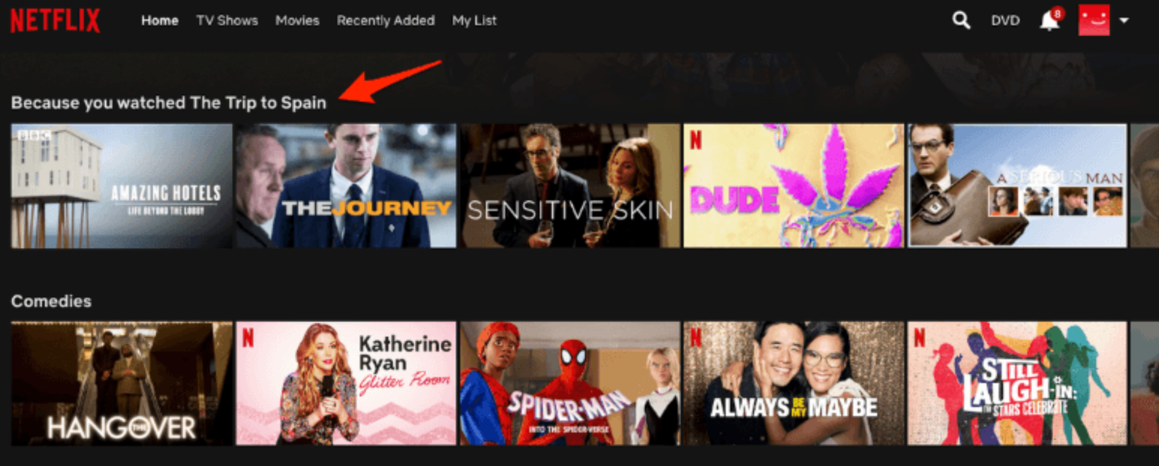
Entertainment / Netflix

Slide 12

E-commerce / Amazon
Notes:
It’s the same as the display tables in the brick-and-mortar stores. But once you start making choices on the platform, Amazon’s recommender system takes over. For example, the other day I was searching for a book titled as the disappointing affirmations: unfollow your dreams, then I was getting recommendations of the books which are of similar taste. By the way, this disappointing affirmations is a very good book, though the title sounds counterintuitive. Okay so now lets move on!

Slide 13

On average, an intelligent recommender system delivers a 22.66% lift in conversions rates for web products ~Nvidia
Notes:
Did you know that on an average an intelligent recommender system delivers approx 23% increase in the conversation rate for the web products as reported by Nvidia. But, wait a minute, do we know how these systems work behind the hood?

Slide 14
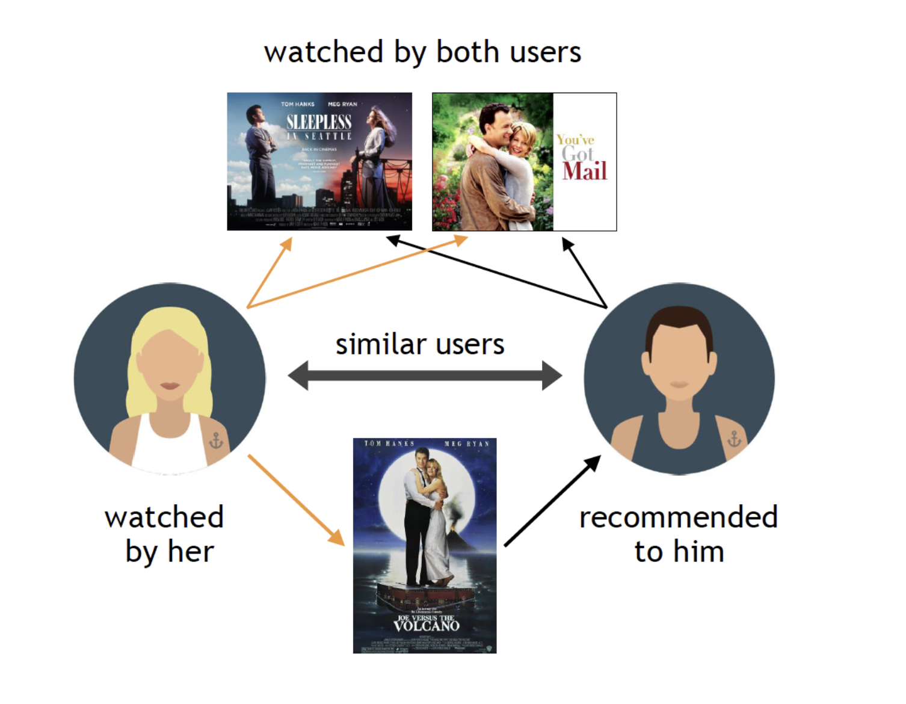
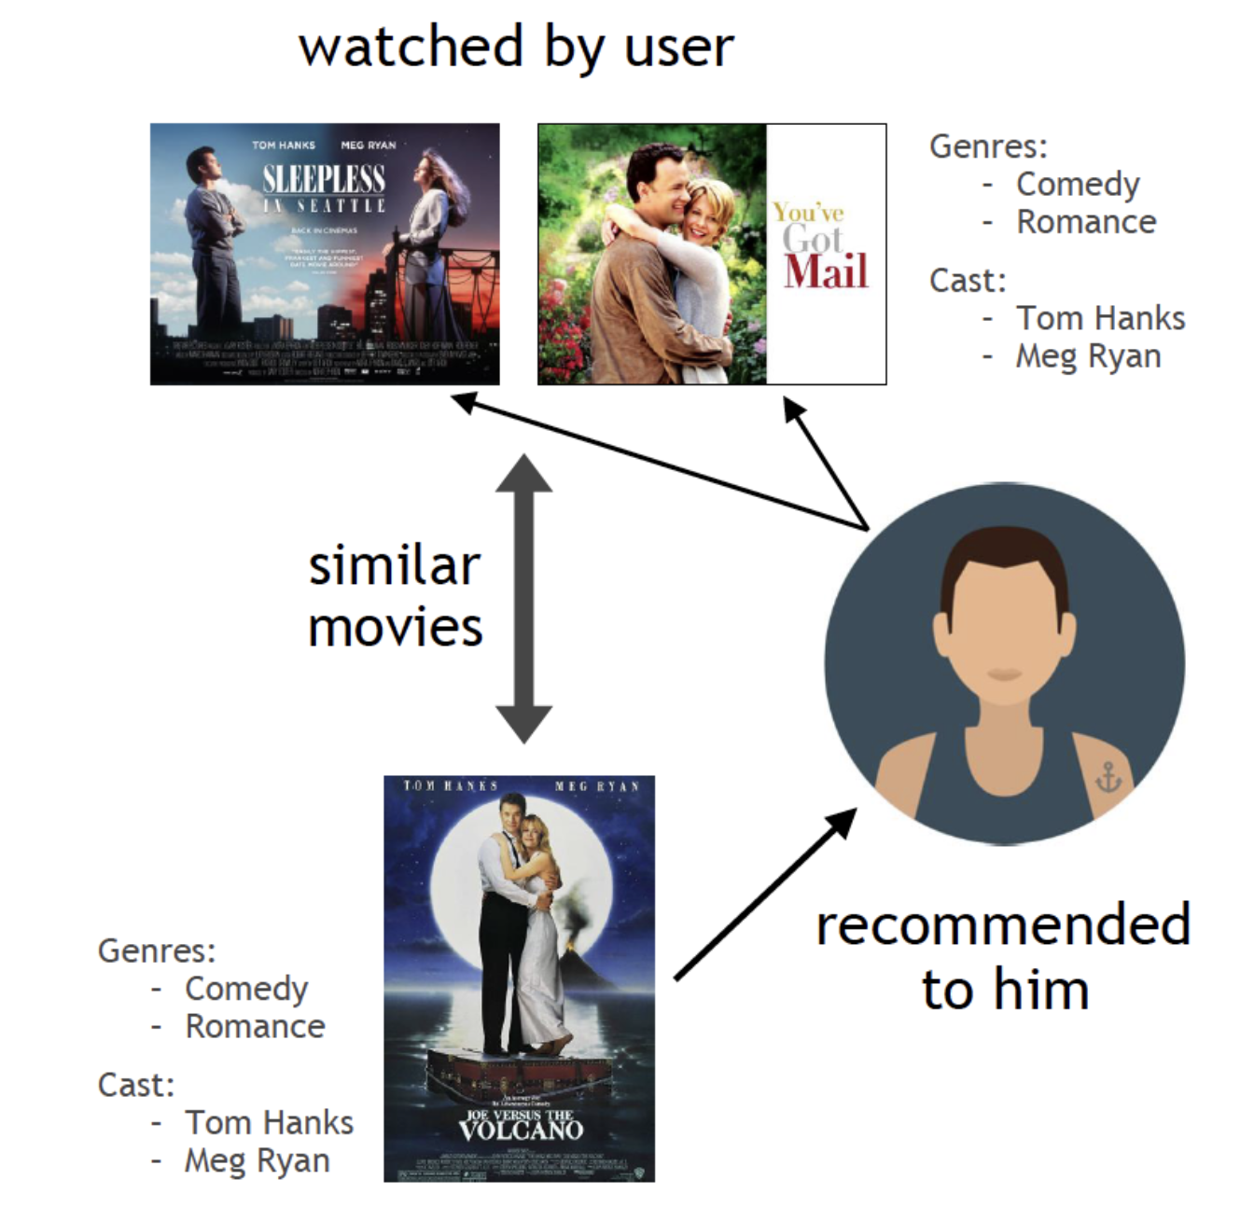
Recommendation System Types
User Preferences (implicit / explicit)
Recommendation System
Recommendations
Collaborative Filtering
Content-based Filtering
Notes:
Well, recommendation system is of two types, collaborative and content based, but from the bird eye view, we provide either implicitly or explicitly the users preferences and then the recommendation system provides the recommendations.
Collaborative filtering algorithms recommend items (this is the filtering part) based on preference information from many users (this is the collaborative part). This approach uses similarity of user preference behavior, given previous interactions between users and items, recommender algorithms learn to predict future interaction. These recommender systems build a model from a user’s past behavior, such as items purchased previously or ratings given to those items and similar decisions by other users. The idea is that if some people have made similar decisions and purchases in the past, like a movie choice, then there is a high probability they will agree on additional future selections. For example, if a collaborative filtering recommender knows you and another user share similar tastes in movies, it might recommend a movie to you that it knows this other user already likes.
Content filtering, by contrast, uses the attributes or features of an item (this is the content part) to recommend other items similar to the user’s preferences. This approach is based on similarity of item and user features, given information about a user and items they have interacted with (e.g. a user’s age, the category of a restaurant’s cuisine, the average review for a movie), model the likelihood of a new interaction. For example, if a content filtering recommender sees you liked the movies You’ve Got Mail and Sleepless in Seattle, it might recommend another movie to you with the same genres and/or cast such as Joe Versus the Volcano.

Slide 15
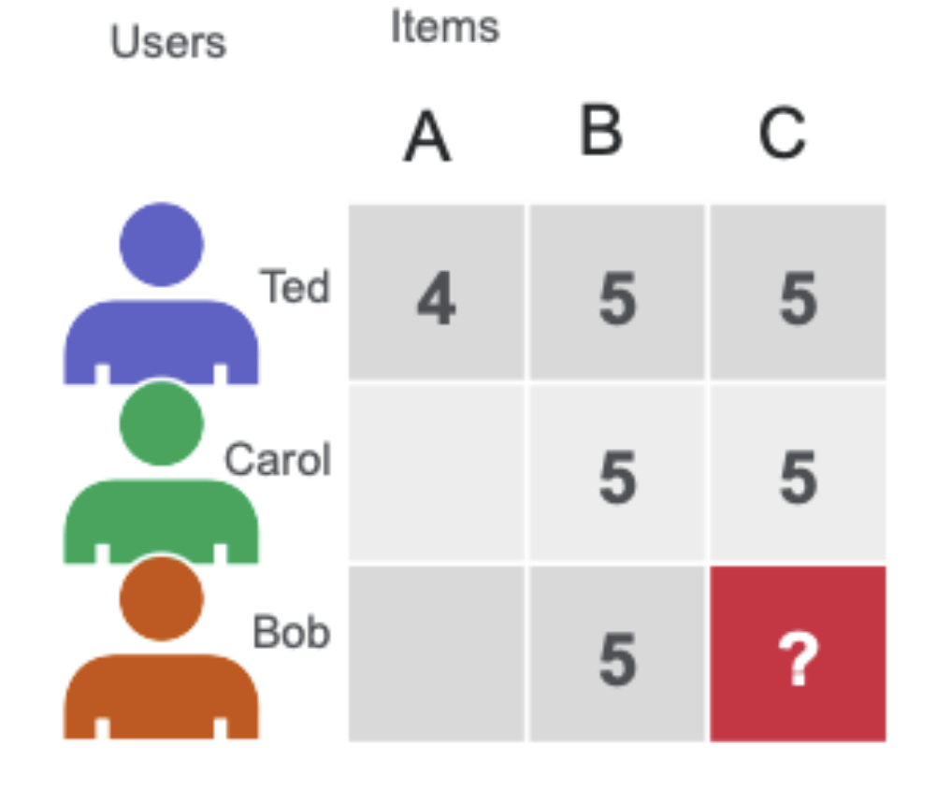
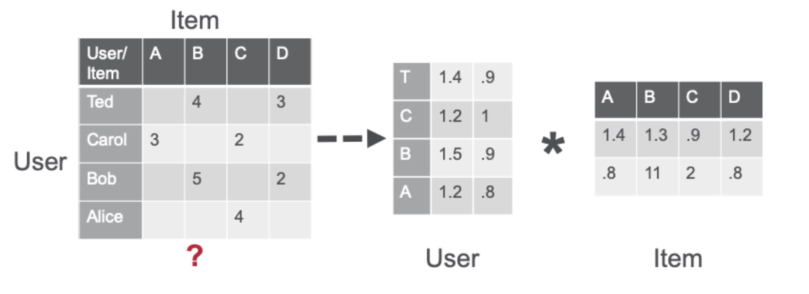
How does Recommendation System work!
Matrix Factorization using Alternating Least Squares algorithm
Notes:
How a recommender model makes recommendations will depend on the type of data you have. If you only have data about which interactions have occurred in the past, you’ll probably be interested in collaborative filtering. If you have data describing the user and items they have interacted with (e.g. a user’s age, the category of a restaurant’s cuisine, the average review for a movie), you can model the likelihood of a new interaction given these properties at the current moment by adding content and context filtering.
Matrix factorization using the alternating least squares (ALS) algorithm approximates the sparse user item rating matrix u-by-i as the product of two dense matrices, user and item factor matrices of size u × f and f × i (where u is the number of users, i the number of items and f the number of latent features) . The factor matrices represent latent or hidden features which the algorithm tries to discover. One matrix tries to describe the latent or hidden features of each user, and one tries to describe latent properties of each movie. For each user and for each item, the ALS algorithm iteratively learns (f) numeric “factors” that represent the user or item. In each iteration, the algorithm alternatively fixes one factor matrix and optimizes for the other, and this process continues until it converges

Slide 16
Demo
 | Item 1 | Item 2 | Item 3 | Item 4 | Item 5 | Item 6
User1 | 5 | 3 | 4
User2 | 4 | 1 | 2 | 5
User3 | 4 | 3 | 5 |  | 2
User4 | 1 | 5 | 3 |  |  | 4

Slide 17
Demo (Books Recommendation)
Use-Case: Given a book name, recommend books based on the similar genre / taste

Slide 18
Challenges in Recommendation System
Cold Start Problem: New users or items have insufficient data to make accurate recommendations.
Sparsity: Often the number of items vastly outnumber the ratings that users have provided.
Scalability: Processing time and resources can be considerable when dealing with large numbers of users and items.
Diversity: Ensuring recommendations include diverse items, not just popular or similar ones.
Notes:
One shortcoming of user similarity, however, is that it requires all the user data to suggest products. It’s called a cold start problem because beginning the recommendation process requires previous data from users. A newly launched e-commerce website, for example, suffers from the cold start problem because it doesn't have a large number of users.

Slide 19
Ways to mitigate challenges in the Recommendation System
Data quality and quantity: Clean and preprocess data to handle missing values, outliers and inconsistencies using data aug., feature eng. techniques.
Hybrid approaches: Combine multiple techniques like content/collaborative and knowledge-based to build robust & personalized recommendations.
Model Selection: Choose recommendation algorithms that strike a balance between complexity and interpretability based on the specific requirements of the application.
Privacy preserving techniques: Implement privacy-preserving mechanisms to protect user data and sensitive information like diff privacy, federated learning.
Notes:
One shortcoming of user similarity, however, is that it requires all the user data to suggest products. It’s called a cold start problem because beginning the recommendation process requires previous data from users. A newly launched e-commerce website, for example, suffers from the cold start problem because it doesn't have a large number of users.

Slide 20
Conclusion
The importance of intelligent systems lies in their ability to leverage data-driven insights to enhance decision-making processes, optimize resource allocation, and personalize user experiences, ultimately driving innovation and competitive advantage.
We need continuous innovation in recommendation systems ensures that they remain relevant and effective in meeting evolving user needs and preferences either by the integration of new data sources, adoption of advanced algorithms to enhance recommendation quality, accuracy, and personalization.
We need to integrate ethical considerations and privacy-preserving mechanisms to protect user data and ensure responsible use of recommendation systems.

Slide 21
Resources
Blog: https://ankane.org/new-ml-gems
Deep Learning course by MIT opencourseware : https://www.youtube.com/watch?v=ErnWZxJovaM
Articles: https://www.codewithjason.com/articles/

Slide 22
Thanks!

